Slide 1
Design Patterns and Functional Programming
OO Patterns in FP
Siva Jayaraman
https://github.com/purefunctions/sdfp_oo_fp_design_patterns

Slide 2
Contents
Overview
OO Design patterns & FP equivalents
Beyond OO Patterns

Slide 3

Notes:
Who has done OO?
Who has used patterns? Who hates them? Who likes them?
Who has over-used them?
Who is new to functional programming?
Languages… Java, Clojure, Python, Haskell

Slide 4
Overview

Slide 5
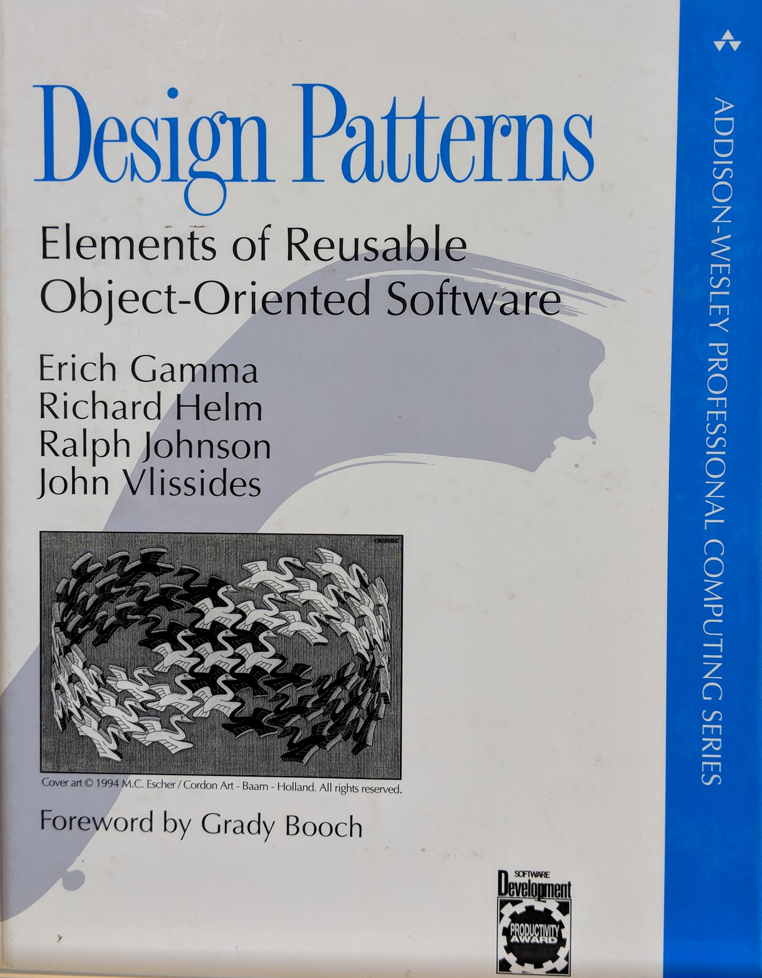
Design Patterns
Gang of Four
Notes:
Released in 1994 and struck a chord in OO community.
It was the new hammer, a hammer that has to be thrown to solve all the problems
Soon, Java and C++ code were sprinkled or should I say, covered, with patterns all over
So, instead of re-use, it because over-use

Slide 6

Design Patterns
“A pattern describes a problem which occurs over and over again, and then describes the core solution to that problem in such a way that you can use this solution a million times over, without ever doing it the same way twice”
- Christopher Alexander
Notes:
Chritopher was talking about buildings, towns and general architecture
GoF wrote the book with good intentions – solve some problems that they saw over and over again
However, the books was written in an age where everyone considered OO as the panacea to solve all problems.
The patterns were designed for OO languages of that age, with that feature set they had in mind.
Times have changed. FP is getting renewed attention these days. So much so that some of these OO languages are borrowing some functional features from FP languages.
The problems that GoF indented to solve still exist. However, they don’t have to be solved in the original intended way. Let’s see how some of these patterns can be solved using FP and functional features in other languages.

Slide 7
OO Patterns & FP equivalents
Notes:
GoF has 23 patterns categorized as Creational, Structural and Behavioral patterns
Creational – how they are created
Structural – How objects are composed or inherited from each other
Behavioral – How responsibilities are assigned to each class/object
We’ll cover 3 of them today
Strategy
Decorator
Visitor

Slide 8
FP Equivalents
OO | FP
SOLID | Functions
Strategy pattern | Functions
Visitor pattern | More functions
Decorator pattern | Function composition
Dependency injection | Functions
Chain of responsibility | Functions
Adapter | Functions

Slide 9
Thank You

Slide 10
3 Patterns in 3 Languages
Notes:
GoF has 23 patterns categorized as Creational, Structural and Behavioral patterns
Creational – how they are created
Structural – How objects are composed or inherited from each other
Behavioral – How responsibilities are assigned to each class/object
We’ll cover 3 of them today
Strategy
Decorator
Visitor

Slide 11
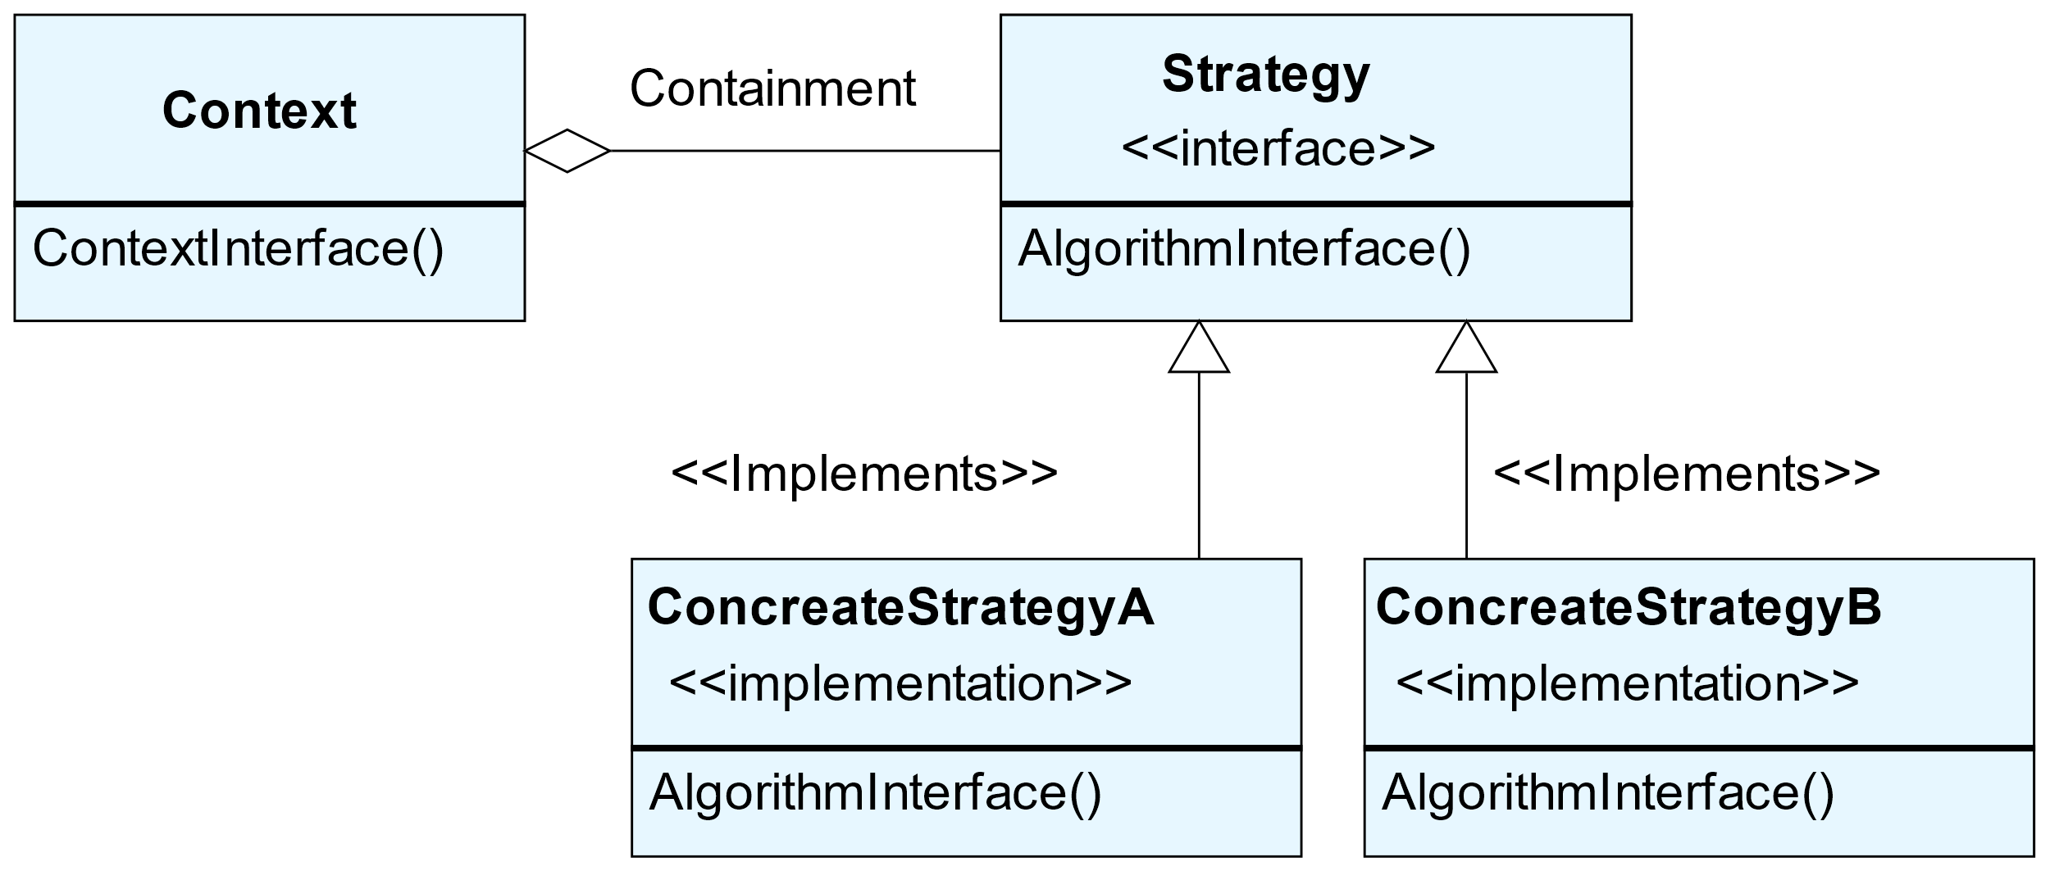
Strategy Pattern
Define a family of algorithms, encapsulate each one, and make them interchangeable. Strategy lets the algorithm vary independently from the clients that use it.
The way it is defined, the strategy can be changed at run time (important for compiled languages)

Slide 12
Strategy Pattern
Code examples in Java, Clojure & Haskell…
Notes:
Introduce a little bit of Clojure (symbols, functions, keywords, maps, lists, partial…)

Slide 13
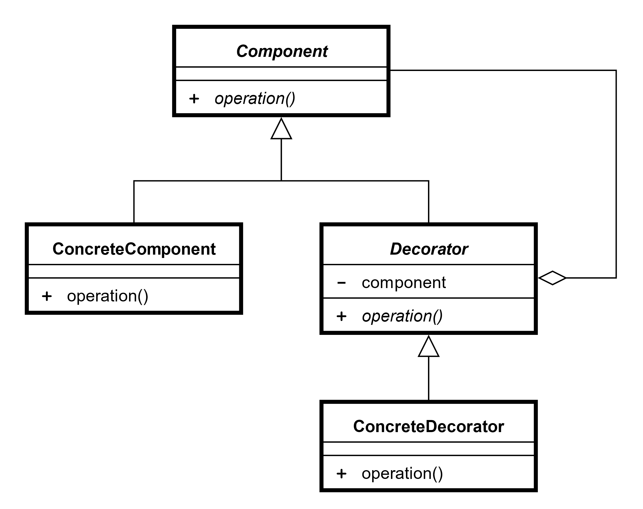
Decorator Pattern
Attach additional responsibilities to an object dynamically. Provides a flexible and dynamic way alternative to sub-classing to extend functionality

Slide 14
Decorator Pattern
Code examples in Java, Clojure & Haskell…

Slide 15
The Expression Problem…
In an Object Oriented Language
 | Insert | Lookup | Delete | Size
OrderedMap | Existing implementations
HashMap
YourCoolNewMap | Your implementations
In structured programming language
 | Insert | Lookup | Delete | Size | Your new op
OrderedMap | Existing Implementations |  |  |  | Your Implementations
HashMap

Slide 16
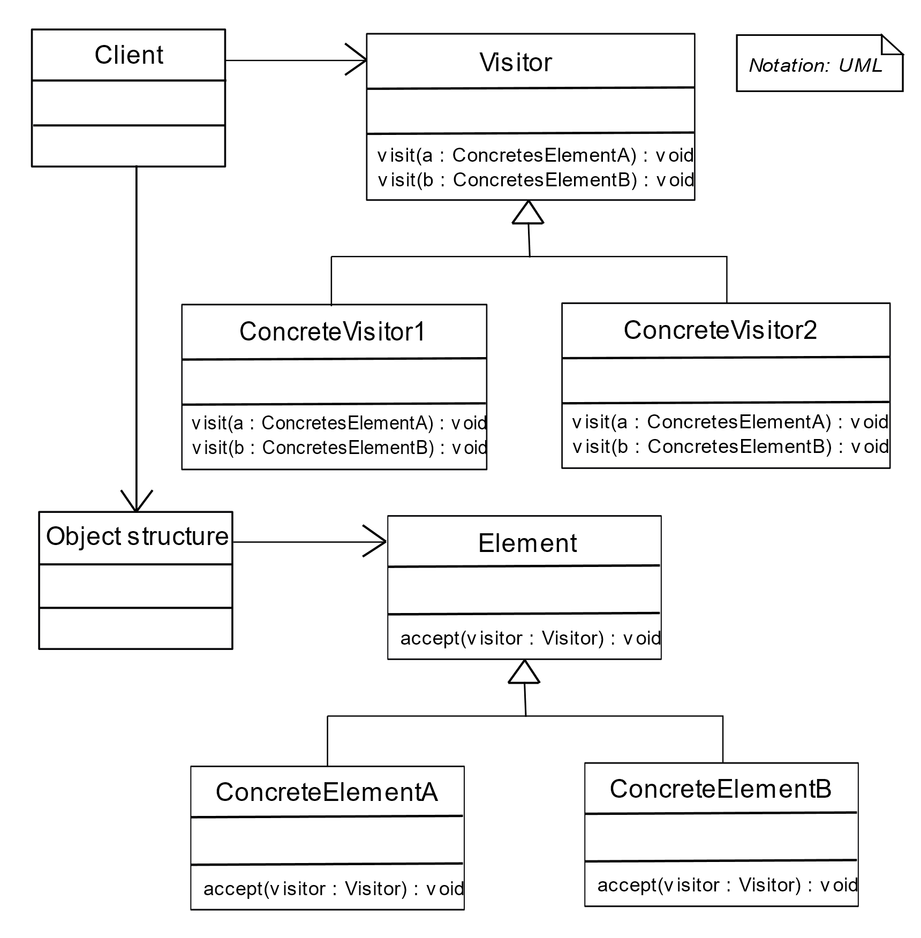
Visitor Pattern
Visitor pattern lets you define a new operation without changing the class of the elements on which it operates
(Does it by inversion of control)

Slide 17
Visitor Pattern
Code examples in Java, Clojure & Haskell…

Slide 18
Beyond OO Patterns

Slide 19
Don’t think in OO patterns
For some other day
Functions, functions… seriously, functions!
Functions in the small and functions in the large
Tail Recursion / Mutual Recursion
Partial function application / Closures
Function Composition
Controlled Mutation, enabling easy concurrency
Lazy collections
Pattern Matching
Functors, Monoids, err.. Monads
Separate functions and data!

